Slide 1
Modern Observability with OpenTelemetry
Georg Pirklbauer
Team OpenTelemetry
Dynatrace

Slide 2
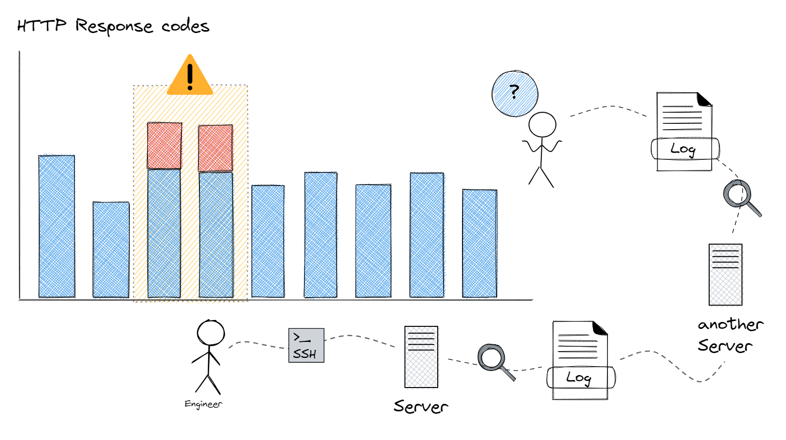

Slide 3
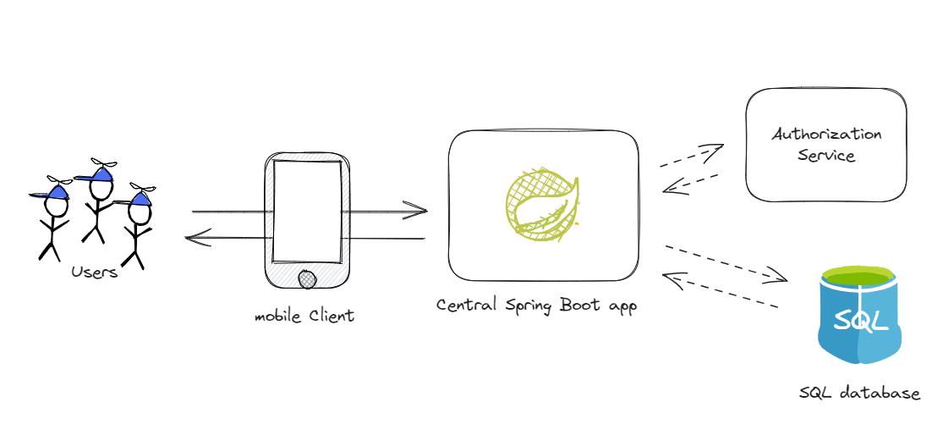
Complicated, even for “simple” systems

Slide 4
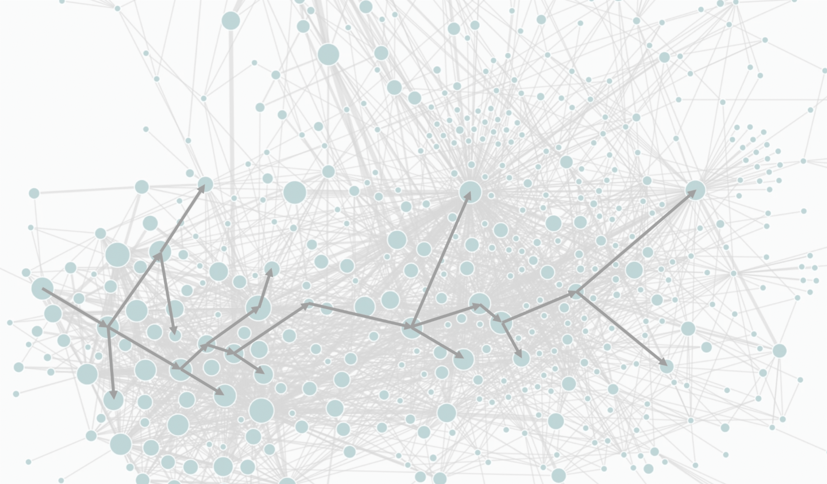
Today's systems are bit more complex…
Conquering Microservices Complexity @Uber with Distributed Tracing

Slide 5
Telemetry data

Slide 6
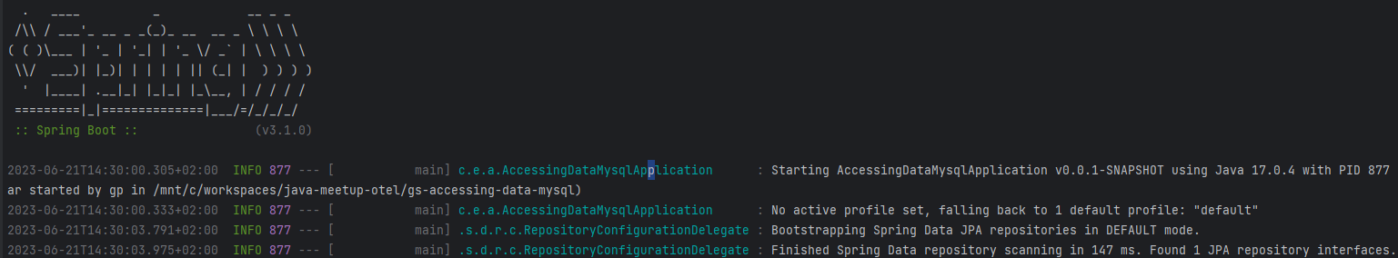
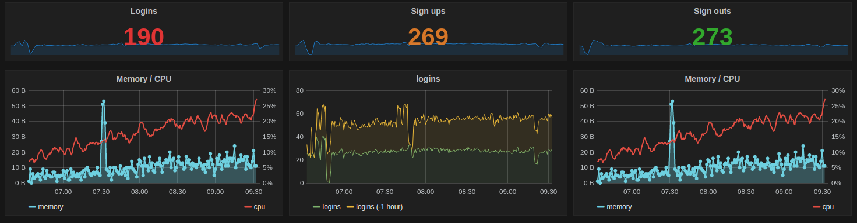
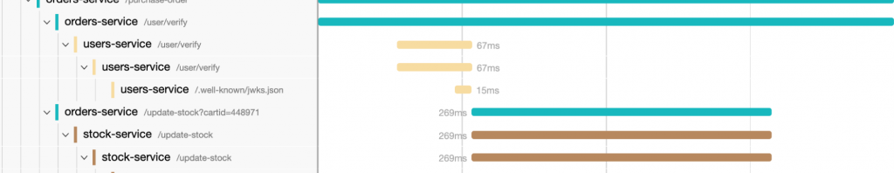
Telemetry data?
Logs
Metrics
Distributed
Traces

Slide 7
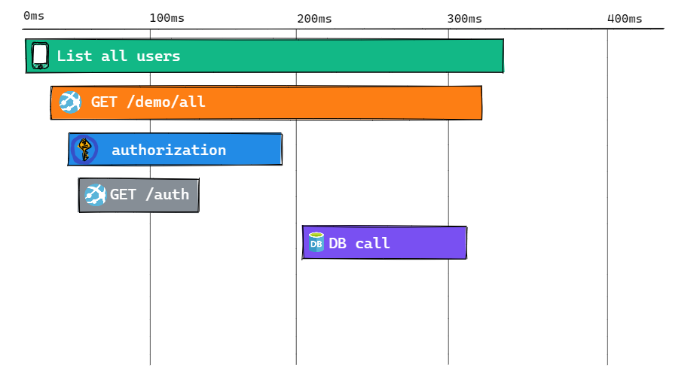
Distributed traces

Slide 8
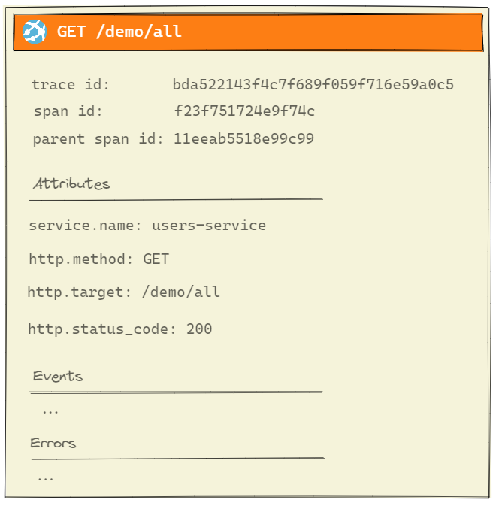
Traces consist of spans

Slide 9
I thought this talk was about observability!

Slide 10
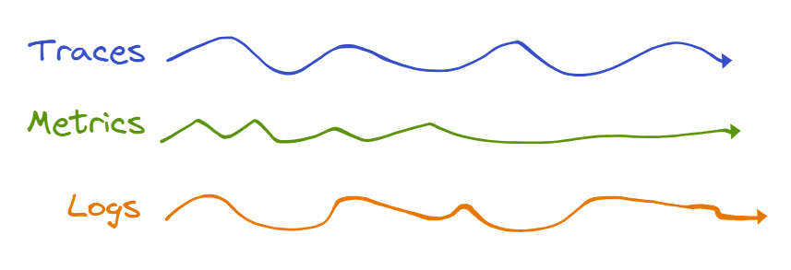
Telemetry data
Often stored in silos, and require manual correlation after the fact

Slide 11
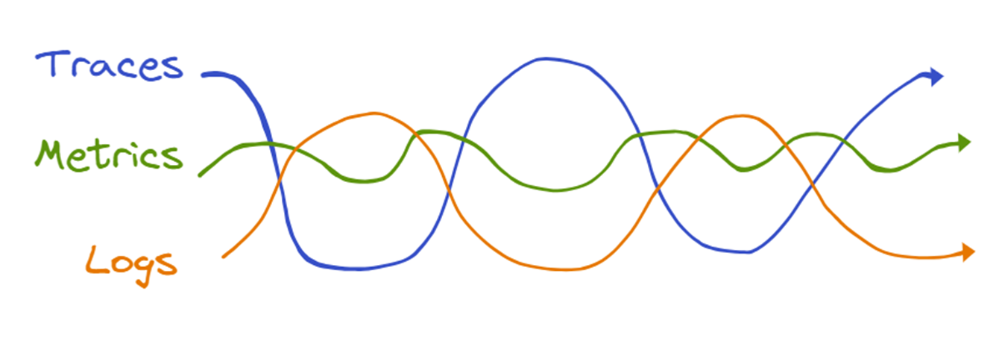
Observability
Observability puts telemetry signals in context
Modern Observability with OpenTelemetry

Slide 12
But Why OpenTelemetry?

Slide 13
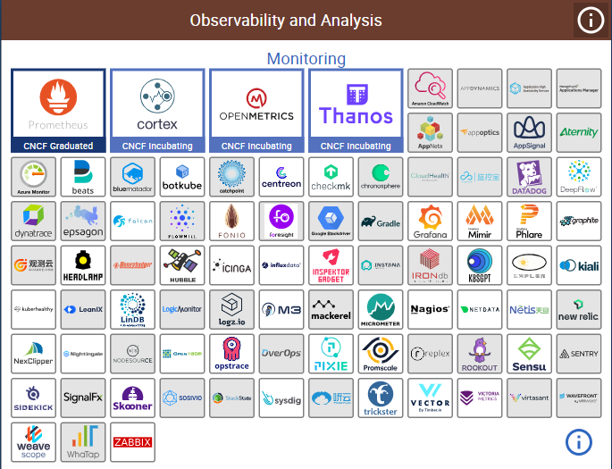
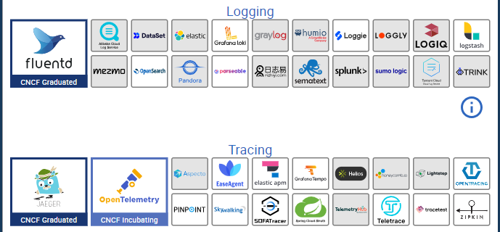
CNCF cloud native landscape
Many tools
Often focused on one telemetry signal
Often incompatible
Vendor lock-in
https://landscape.cncf.io/

Slide 14

OpenTelemetry
a vendor-neutral, open-source Observability framework for instrumenting, generating, collecting, and exporting telemetry data
the de-facto standard for telemetry data
not a backend!
Logs, Metrics, Traces are stable in OTLP (the OpenTelemetry Protocol)
More signals are in the works (real user monitoring, profiling,…)
https://opentelemetry.io/docs/

Slide 15
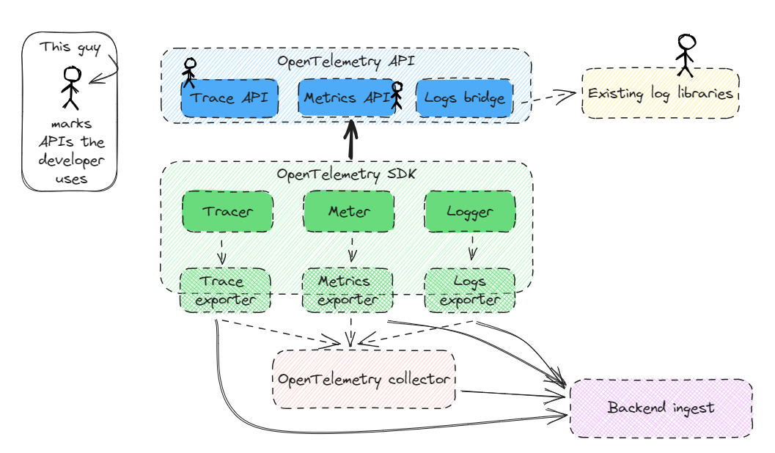
OTel architecture
Notes:
Can build telemetry into the library (API)
Can be included in the in-house shared packages, adding not vendor-locked-in observability
The API will do nothing until the library is pulled into an app that provides an SDK, and then will immediately start exporting data without having to change the lib
libraries that are reused across departments can now provide business metrics

Slide 16
Cool! But how does that help me?

Slide 17
From this

Slide 18
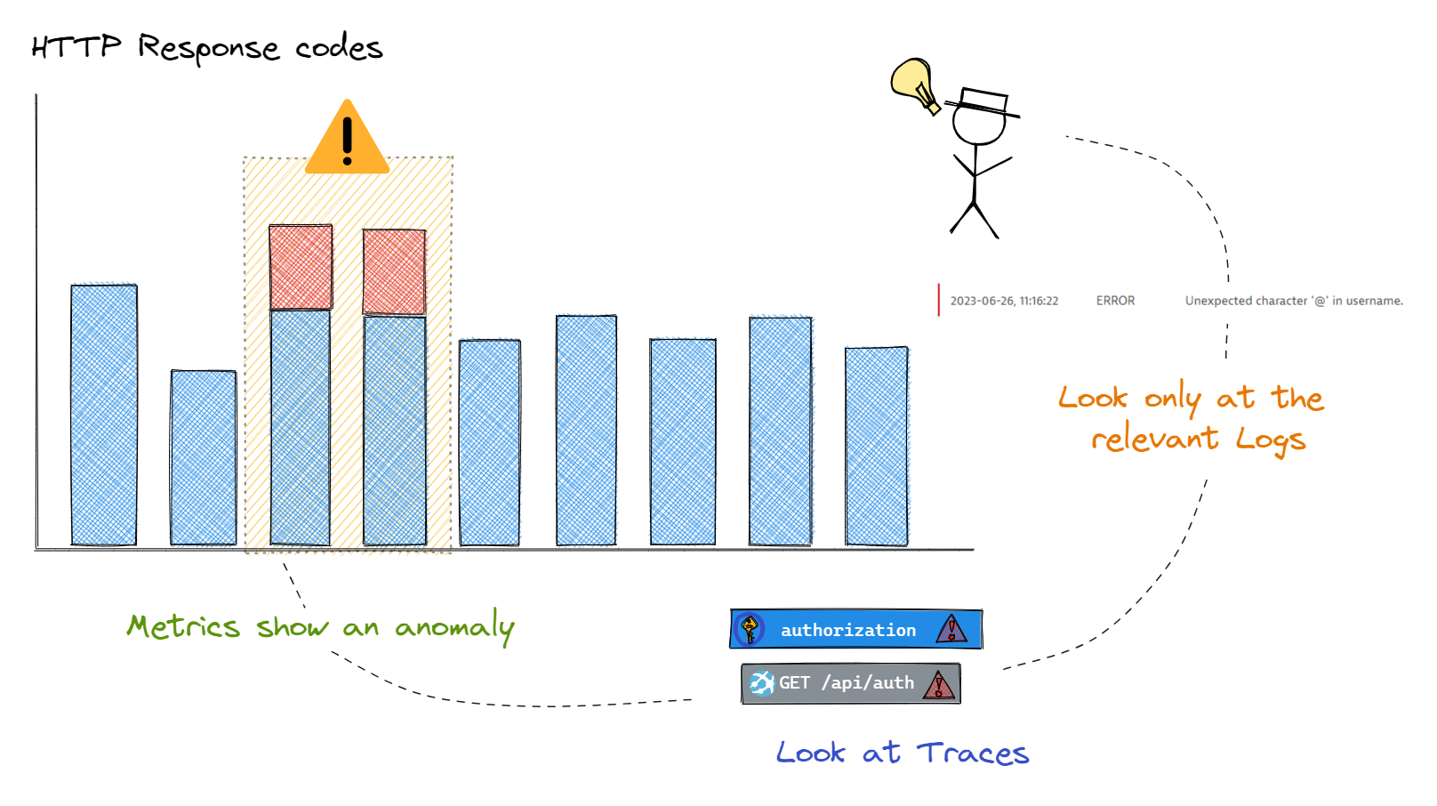
To this

Slide 19
Demo
Starting Point:
Accessing Data with MySQL Spring Boot guide

Slide 20
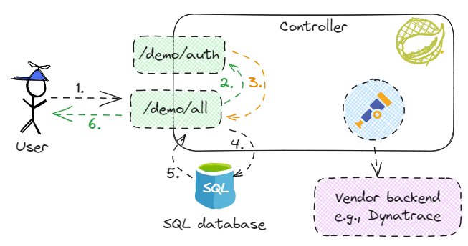
Demo app architecture
Notes:
Using Dynatrace, but NO Dynatrace code in my app, so data can be sent to whatever backend that understands OTLP

Slide 21
Finished example
Find it on my fork on GitHub:
https://github.com/pirgeo/gs-accessing-data-mysql/
Branch otel-java-meetup for initial state
Branch otel-java-meetup-manual for manual instrumentation
Contains SDK setup code
Branch otel-java-meetup-automatic for auto-instrumentation
SDK automatically set up by javaagent
Can be extended with manual instrumentation

